Slide 1

LOAN PORTAL
(OHI Functional Unit)

Slide 2
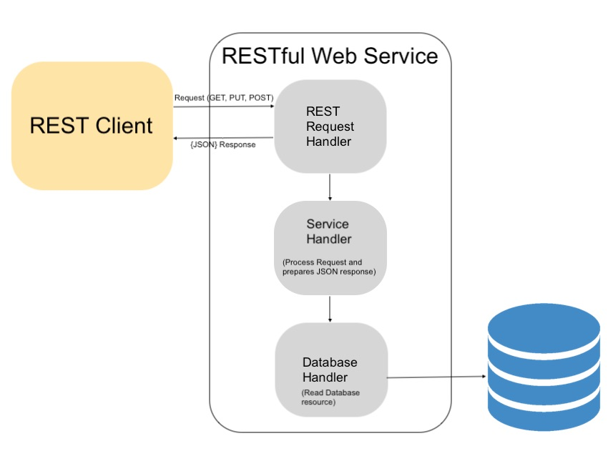
Architecture

Slide 3
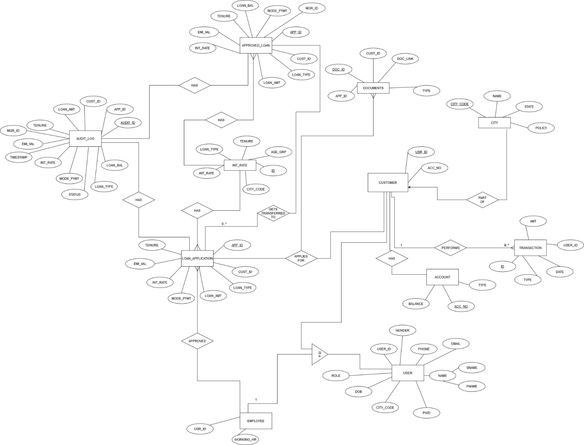
E-R Diagram

Slide 4
Web Services
The term Web service (WS) is either:
a service offered by an electronic device to another electronic device, communicating with each other via the World Wide Web, or
a server running on a computer device, listening for requests at a particular port over a network, serving web documents (HTML, JSON, XML, images), and creating web applications services, which serve in solving specific domain problems over the Web (WWW, Internet, HTTP)
DBConnection Service
Login Service
Signup Service
Mapper Service
Loan Service

Slide 5
REST API’s
Representational state transfer (REST) is a software architectural style that defines a set of constraints to be used for creating Web services. Web services that conform to the REST architectural style, called RESTful Web services, provide interoperability between computer systems on the internet
Apply Loan
Review Loan
View Loan Application
Get Interest Rate
Get Transactions

Slide 6
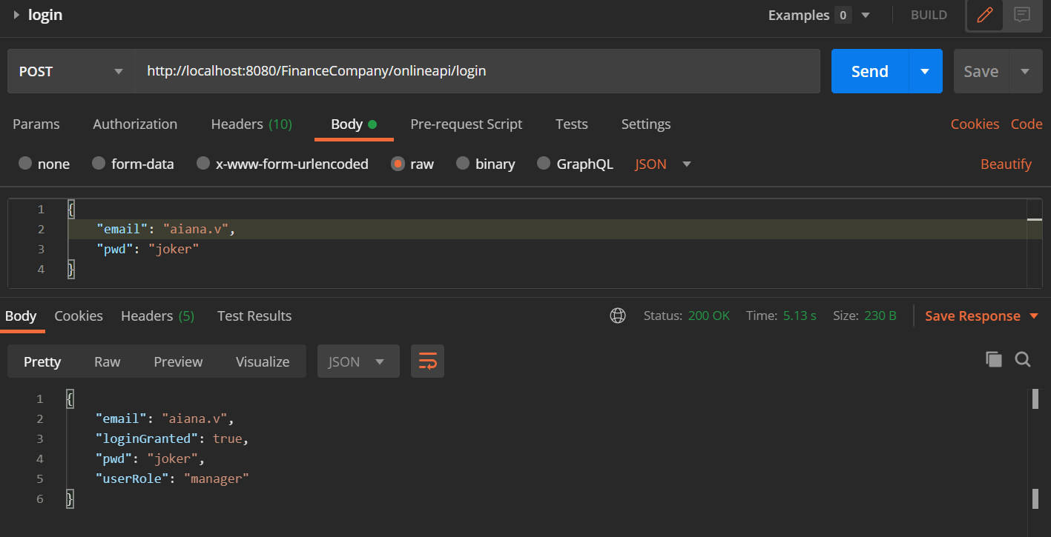
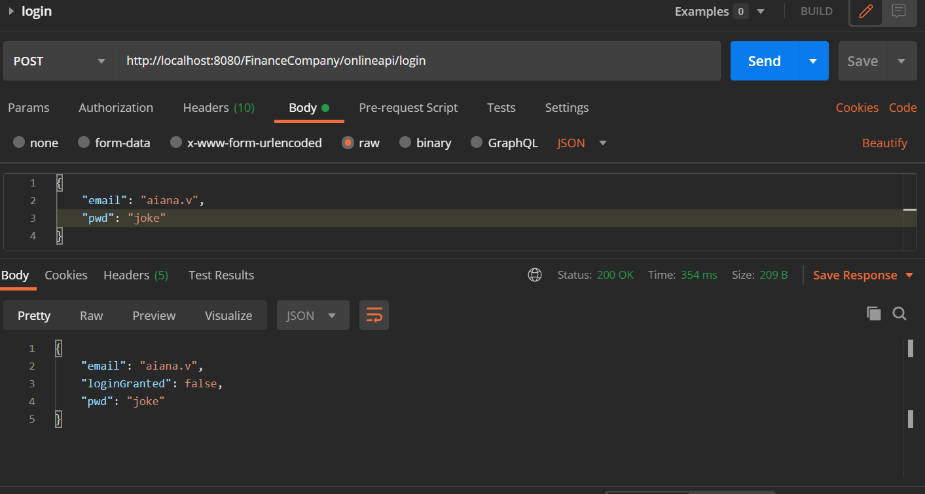
Postman
Postman is a collaboration platform for API development. Postman's features simplify each step of building an API and streamline collaboration so you can create better APIs—faster.
Login API

Slide 7
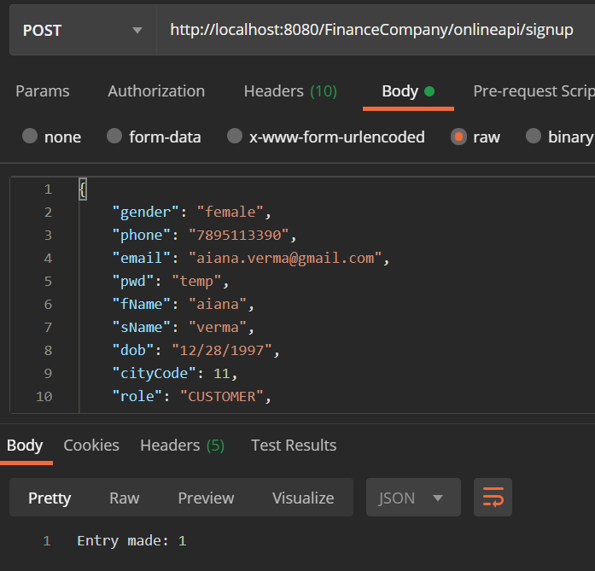
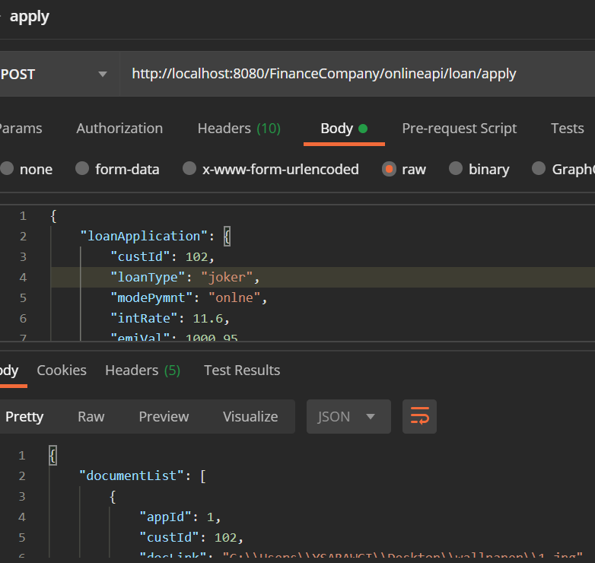
Signup API
Apply API

Slide 8
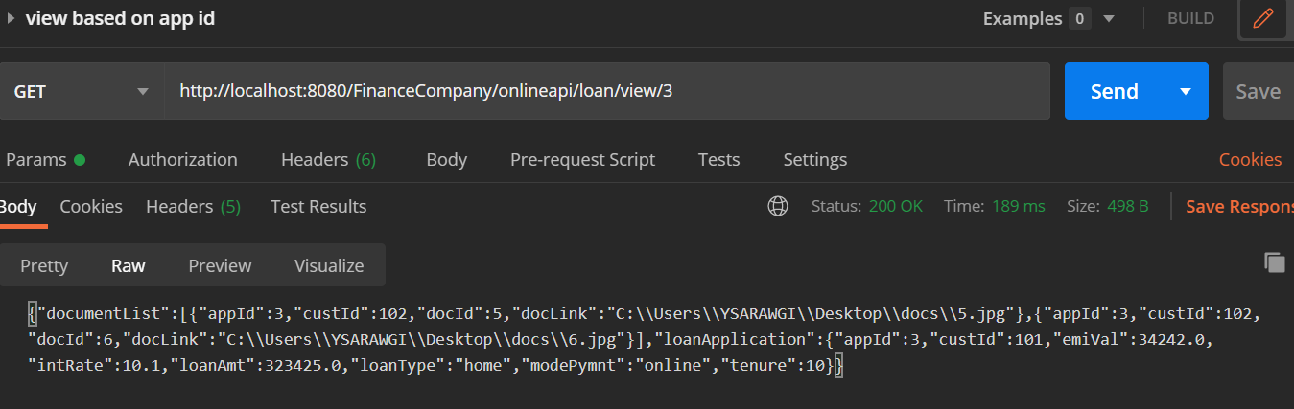
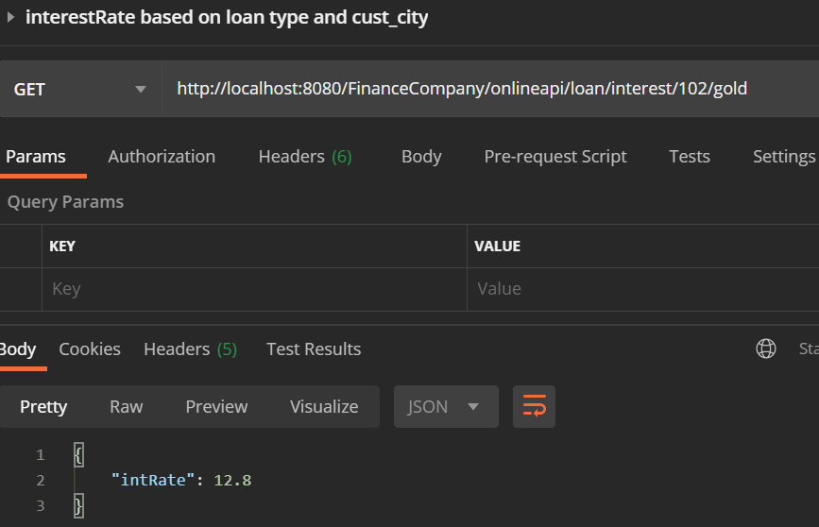
View API
Interest Rate API

Slide 9
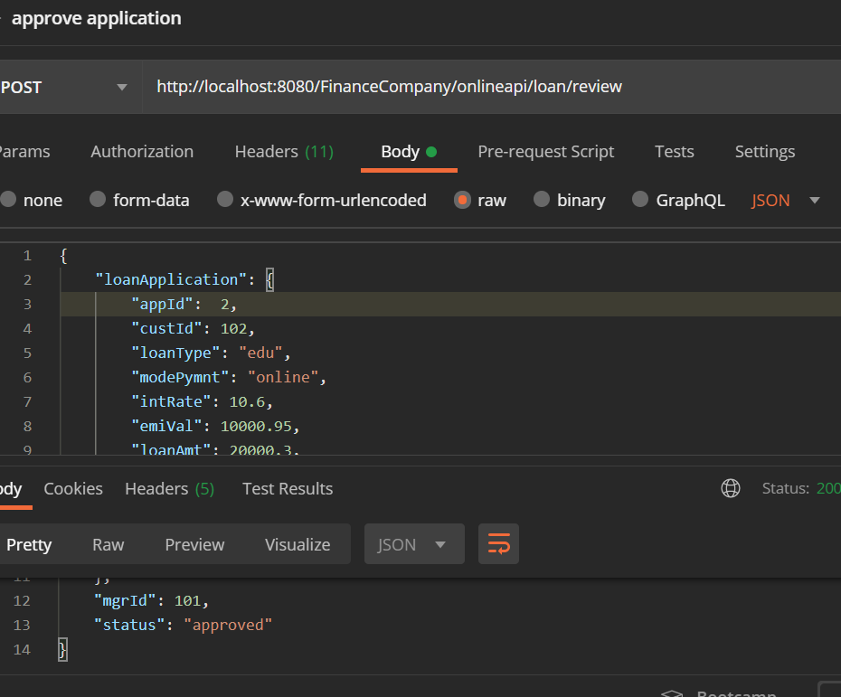
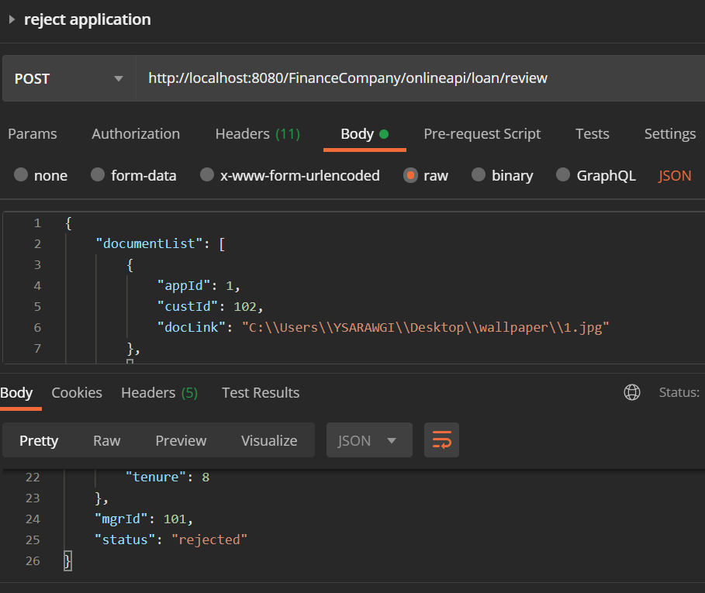
Approve API
Reject API

Slide 10


REST Client
User
Manager
Customer

Slide 11
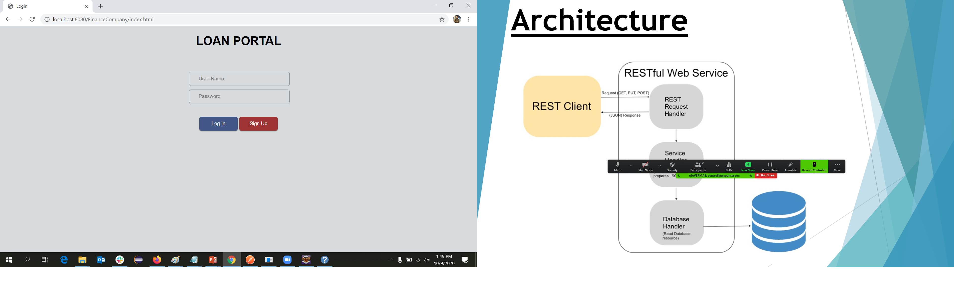
User Interface

Slide 12
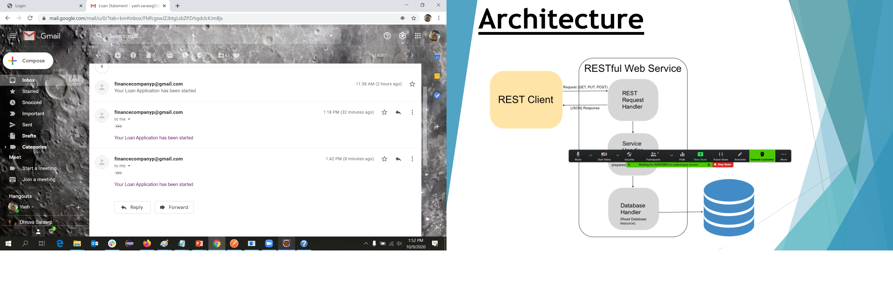
Mail Response(on approval)

Slide 13
THANK YOU

